Slide 1
COMPUTER SCIENCE CONCEPTS (컴퓨터과학 개념)
DJIBRIL COULYBALY
(지브릴 콜리빌리)

Slide 2
TABLE OF CONTENTS
01
WHAT IS PROGRAMMING?
02
ALGORITHMS / INSTRUCTIONS
03
PARTS OF A COMPUTER
04
CRYPTOGRAPHY
How to tell a computer what to do
How a computer looks like
Keep information secret and safe

Slide 3
TABLE OF CONTENTS
05
INTERNET DO’S AND DON'TS
How to stay safe on the internet

Slide 4
WHAT IS PROGRAMMING? (프로그래밍이란?)

Slide 5

WHAT IS A PROGRAMMER
A programmer is a person who codes programs and software for computers.
They’re needed and valuable in every job.

Slide 6
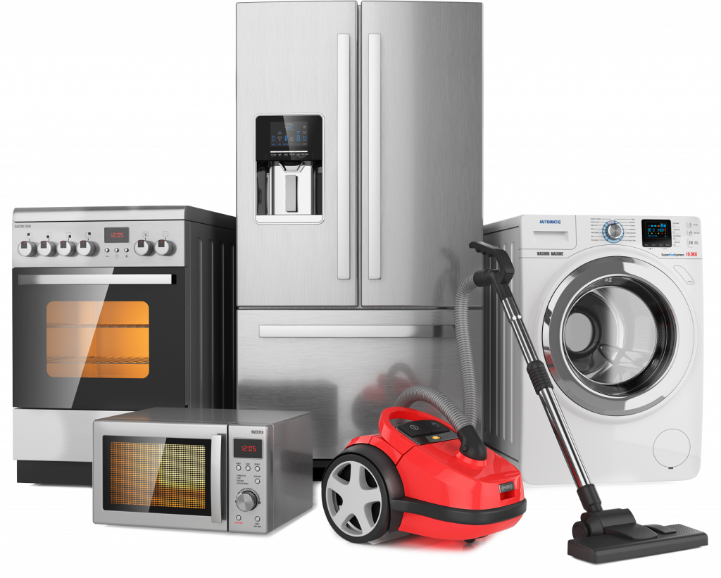

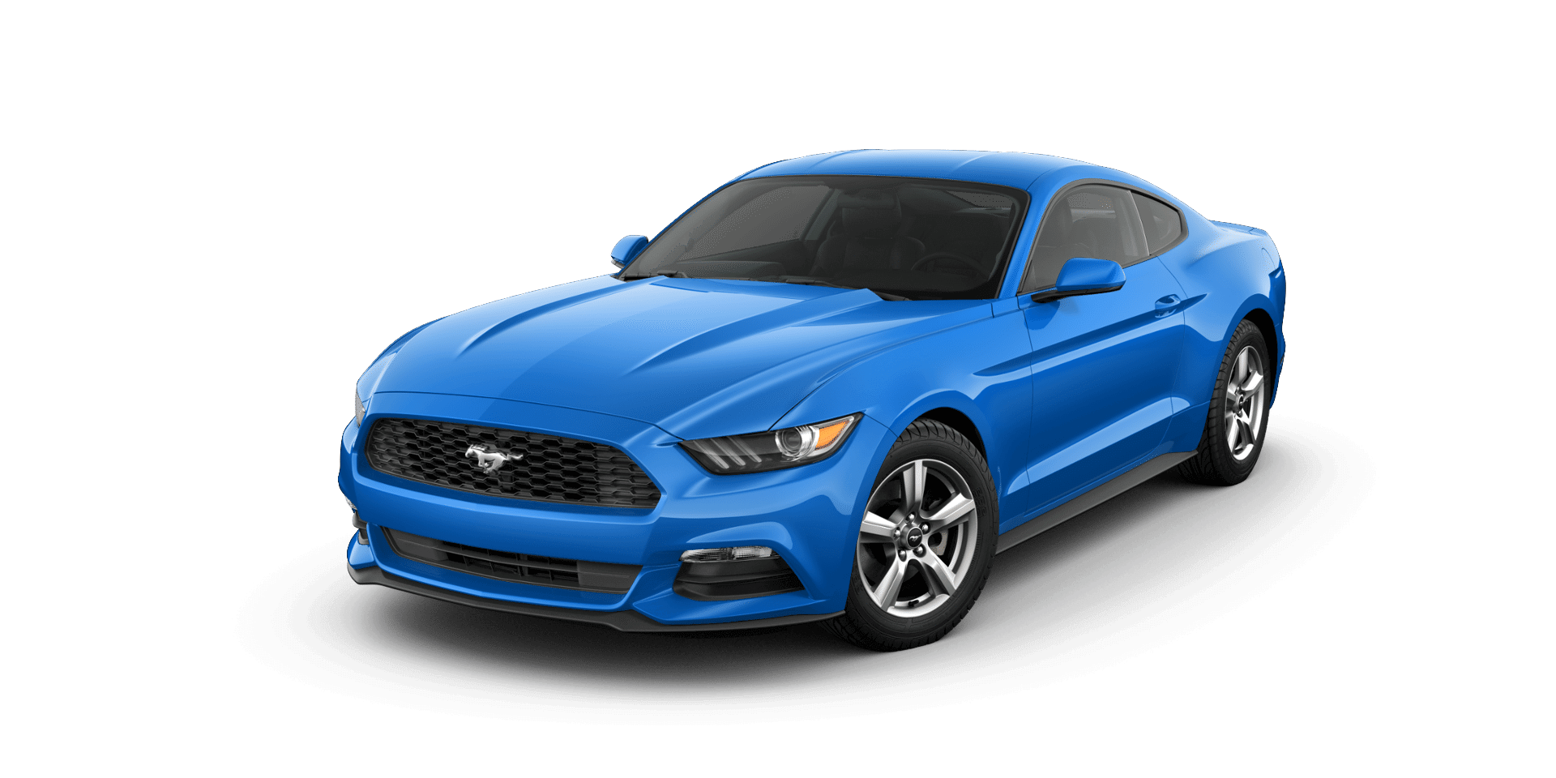
CARS
HOME APPLIANCES

Slide 7


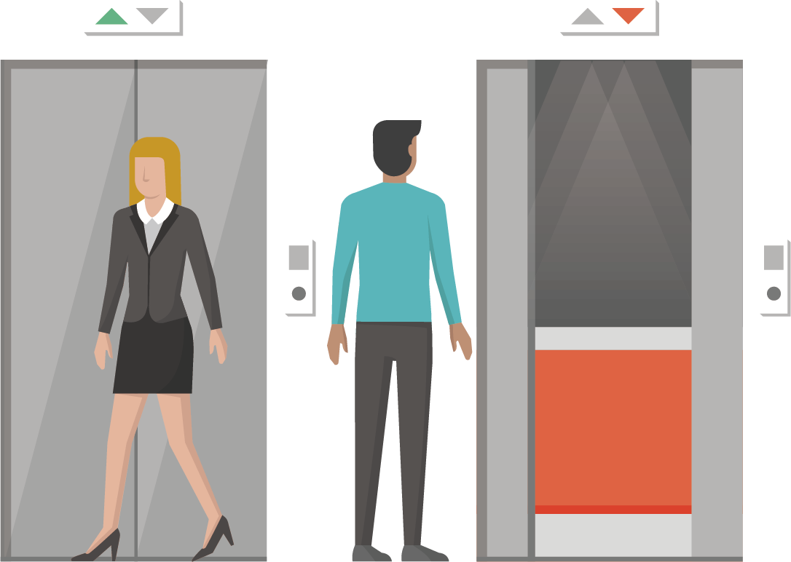

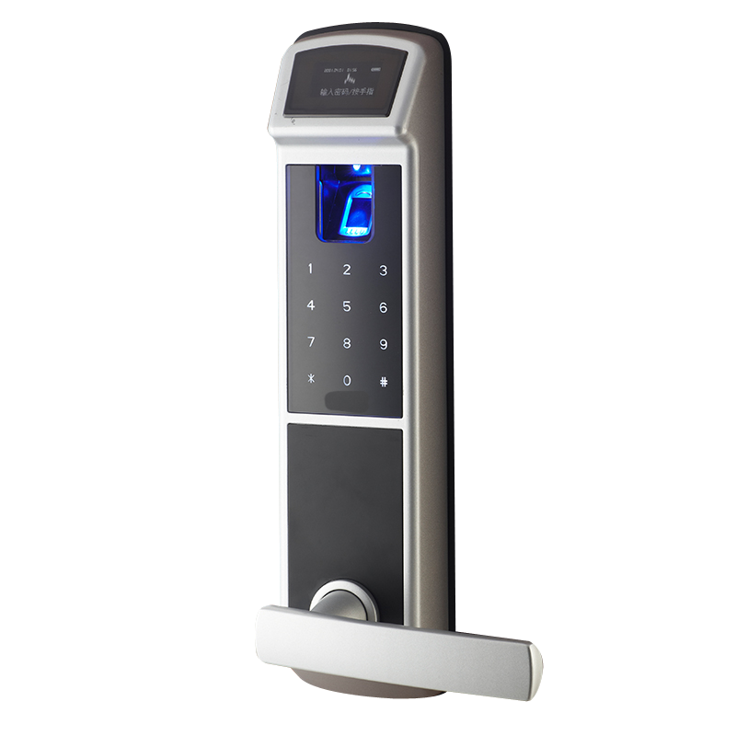
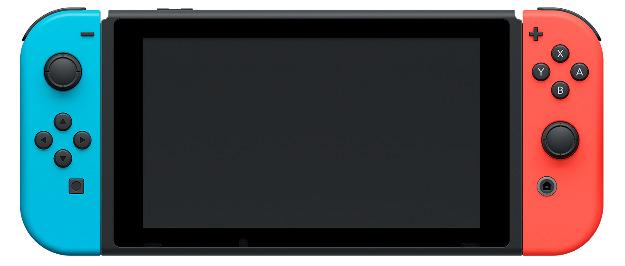
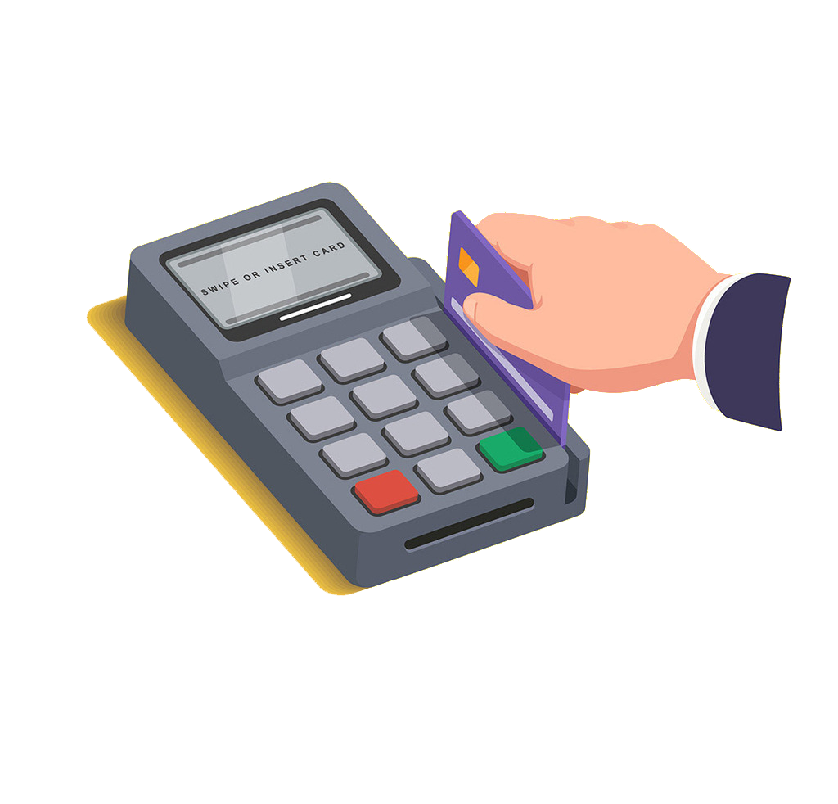
ELEVATORS, DOORS AND SHOPS
VIDEO GAMES

Slide 8


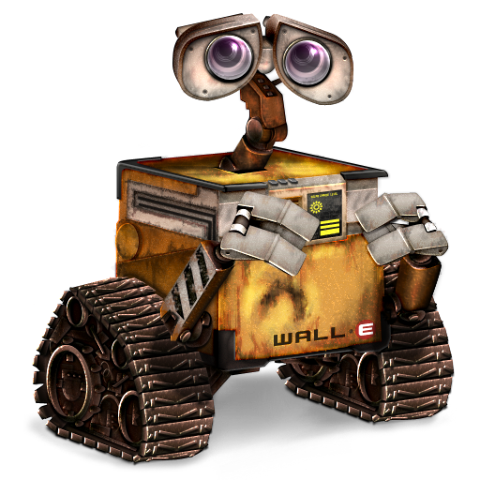


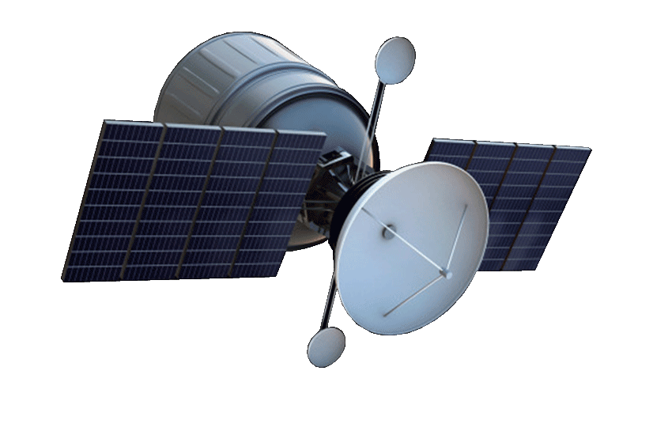

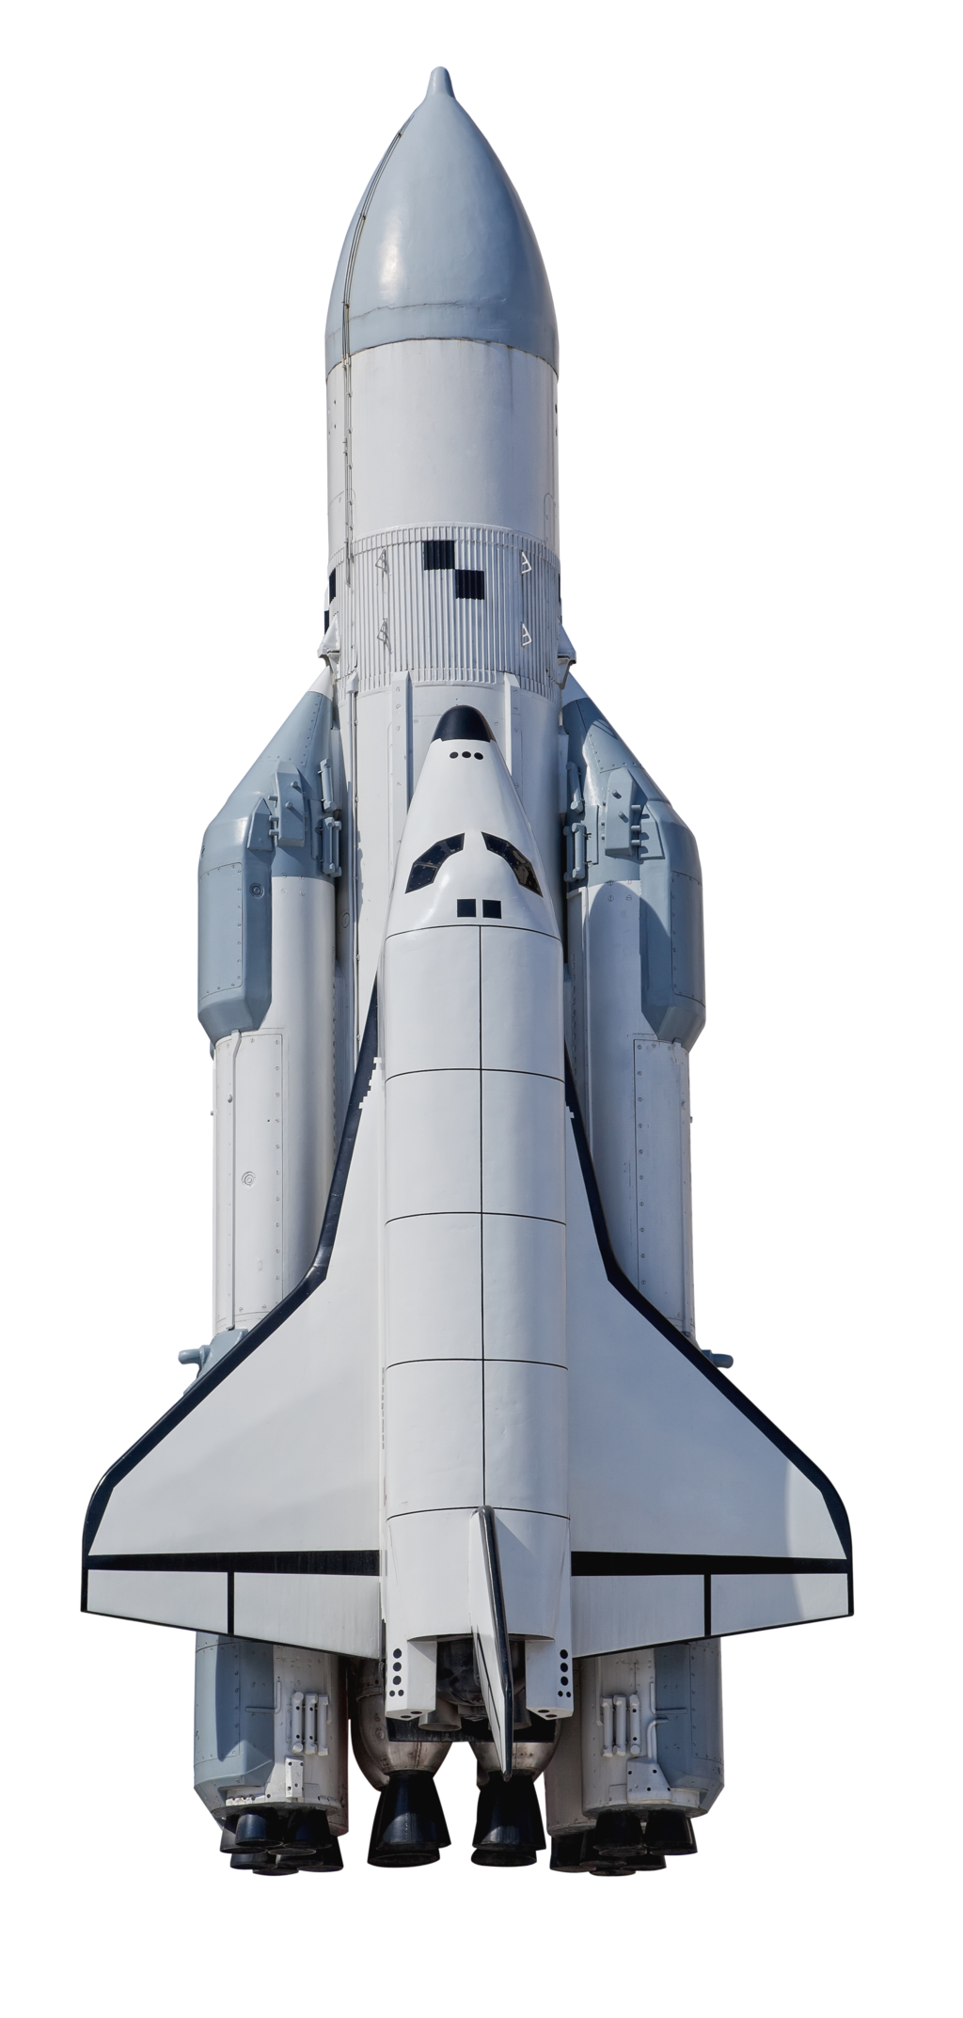


SPACE
SOCIAL
MEDIA

Slide 9
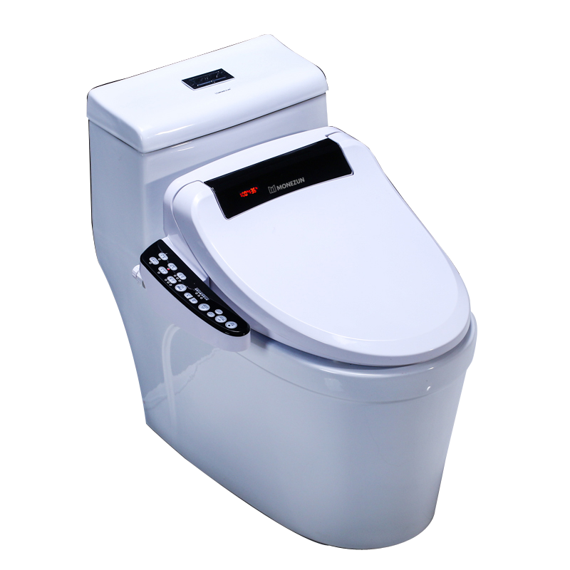
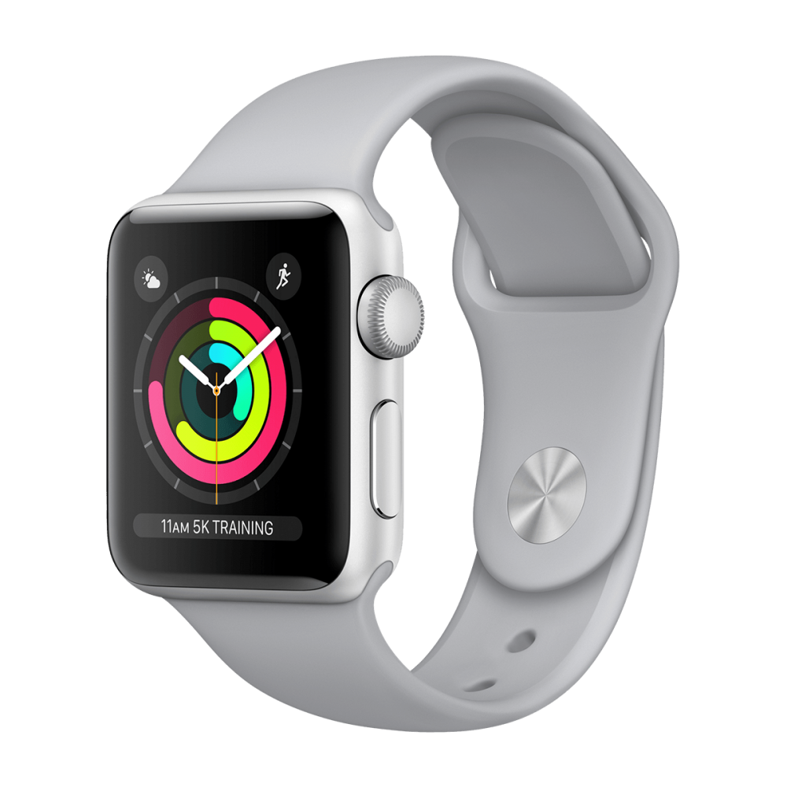
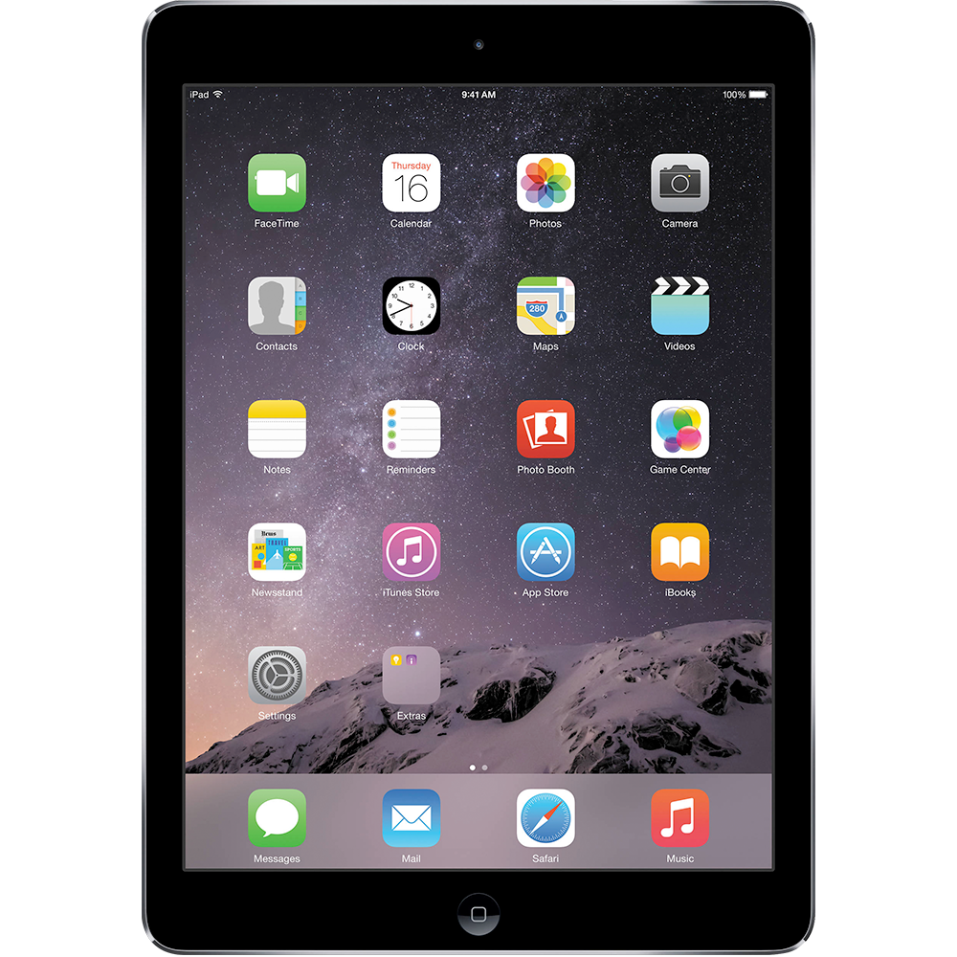

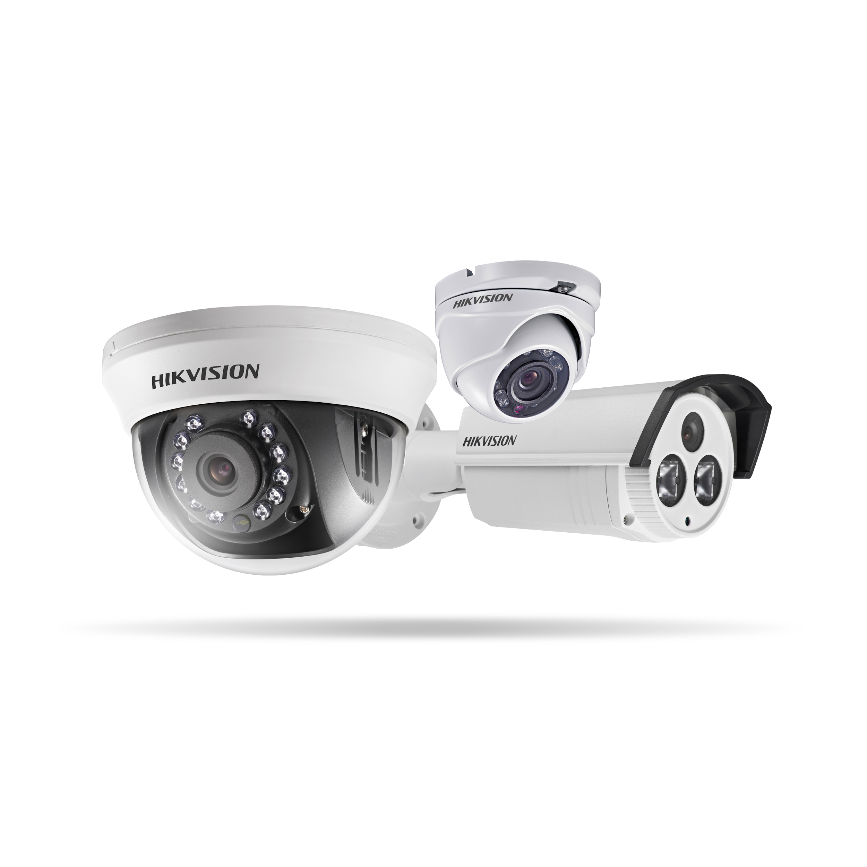
DEVICES AND SECURITY
TOILETS

Slide 10
You need these items in order to be a good programmer!

Slide 11

1. BE CREATIVE
Using your imagination to think of new and fun ways to solve a problem

Slide 12

2. TEAMWORK
You need to be able to work and get along with people in a team to get the job done

Slide 13
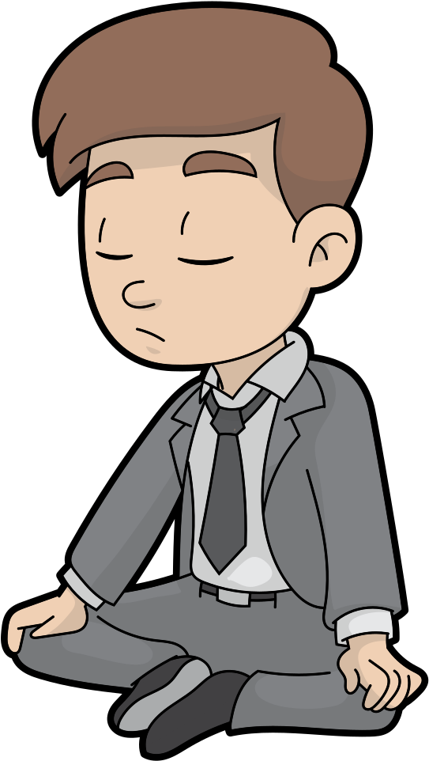
3. PATIENCE
Keep trying to fix a problem even if your answer isn’t working

Slide 14
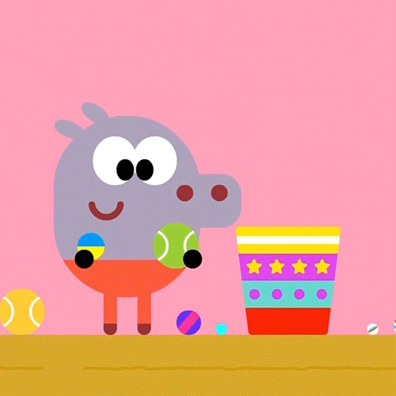
4. BE ORGANISED
Managing your time and how much work you have to do.
Paying attention to small details

Slide 15

5. OPEN TO LEARNING
Always trying to learn new programming languages & ways to solve problems.

Slide 16
THANK YOU FOR WATCHING!
봐줘서 고마워!

